Slide 1
Texas Bio-Science Institute
I love computers… in a computer, numbers make colors; therefore, I love math
Oct 24, 2014
R. Craig Collins
Temple College CIS Faculty

Slide 2
Making a web page
<html>
<head><title>My First Web Page</title></head>
<body
bgcolor="white"
text="black">
<h2>Hi</h2>
</body>
</html>

Slide 3
Word colors
Black
White
Red
Green
Blue
Yellow …

Slide 4
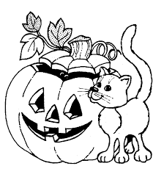
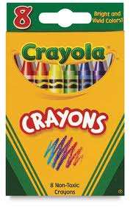
Remember when…

Slide 5
EIGHT?
Only 8?
I need more colors
Not 24
Not 64

Slide 6
I want
16,777,216 colors!

Slide 7
Some background
Look at your monitor; see that line?

Slide 8
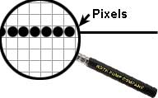
Look closer

Slide 9
Really look at the pixels
24 1s and 0s for Red and green & blue

Slide 10
It turns out
Your monitor can display
256 shades of red
256 shades of green, and
256 shades of blue, or
2⁸x2⁸x2⁸⁼2²⁴
or 16,777,216 colors

Slide 11
Why 2⁸? Why 2²⁴?
Everything in a computer is a 1 or 0
Bits
Yes or no
True or false
On or off…
All can be represented with 1 or 0

Slide 12
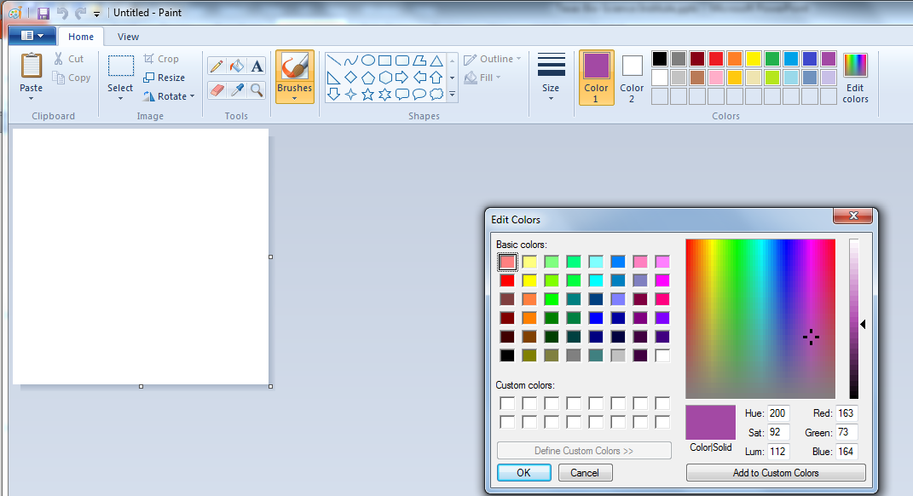
Take a look at colors in Paint

Slide 13
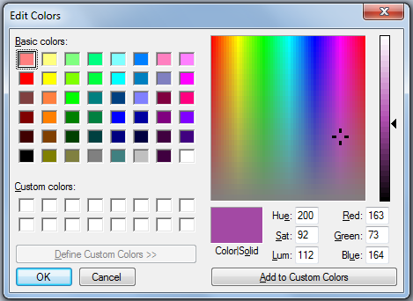
Again, up to 256 each
for a total 16 16,777,216 possible…

Slide 14
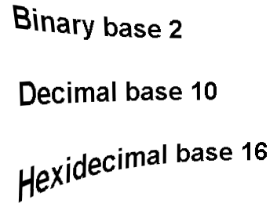
But computers…
Use different numbers than we do

Slide 15
Counting: you can count, right?
Start with
0
1
2
3
4
5
6
7
8
9
10

Slide 16
Three rules of counting
Modern numbering systems start with 0
The number of symbols is determined by the base
5 to us is actually 5₁₀ (Why base 10?)
When you run out of numbers, you add a decimal to the left and start over

Slide 17
Count like a computer
0
1
2
3
4
5
6
7
8
9
10
0
1
10
11
100
101
110
111
1000
1001
1010

Slide 18
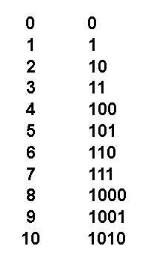
Can you guess
What the next
number that ends with
all all zeros is in binary,
base 2?

Slide 19
Can you guess
What the next
number that ends with
all all zeros is in binary,
base 2?

Slide 20
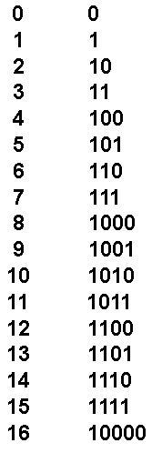
Stuff

Slide 21
Problem
Paint will give you the decimal number, but the computer wants something else
You can’t even remember a 7 digit phone number, no way you can remember a 24 digit number to represent a color…
We need something shorter

Slide 23
Stuff
0
1
2
3
4
5
6
7
8
9

Slide 24
Stuff
0
1
2
3
4
5
6
7
8
9
A
B
C
D
D
F
10

Slide 25
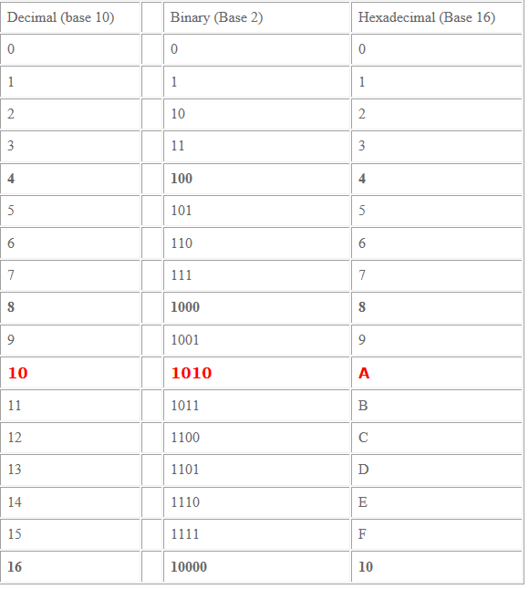

Slide 26
Remember
the doubling
When looking
at 1 followed
by nothing?
ie 1, 10, 100

Slide 27

Remember the doubling?
This leads to the
powers of 2 number line
Notice 2⁸ is 256

Slide 28
Let’s start to convert
3 rules for decimal-binary
Always write out the powers of 2 number line
x₁₀ to x₂ is subtracting
x₂ to x₁₀ is adding
We’ll use only 1s and 0s, they go
under the number line

Slide 29
Example 52₁₀ to ?₂
What is the largest number you can subtract from 52?
32

Slide 30
Example 52₁₀ to ?₂
1
What is the largest number you can subtract from 52?
32, put a 1 under the number line
Do the math 52-32=20

Slide 31
Example 52₁₀ to ?₂
1
We have 20
Can you subtract the next one, 16?
1 means yes, 0 means no

Slide 32
Example 52₁₀ to ?₂
1 1
We have 20
Can you subtract the next one, 16?
1 means yes, 0 means no
Do the math 20-16=4

Slide 33
Example 52₁₀ to ?₂
1 1
We have 4
Can you subtract the next one, 8?
1 means yes, 0 means no

Slide 34
Example 52₁₀ to ?₂
1 1 0
We have 4
Can you subtract the next one, 4?
1 means yes, 0 means no

Slide 35
Example 52₁₀ to ?₂
1 1 0 1
We have 4
Can you subtract the next one, 4?
1 means yes, 0 means no
Do the math, 4-4=0

Slide 36
Example 52₁₀ to ?₂
1 1 0 1
We have 0
Can you subtract the next one, 2?
1 means yes, 0 means no

Slide 37
Example 52₁₀ to ?₂
1 1 0 1 0
We have 0
Can you subtract the next one, 1?
1 means yes, 0 means no

Slide 38
Example 52₁₀ to ?₂
1 1 0 1 0 0
So 52₁₀ to ?₂
110100
Let’s check with a calculator

Slide 39
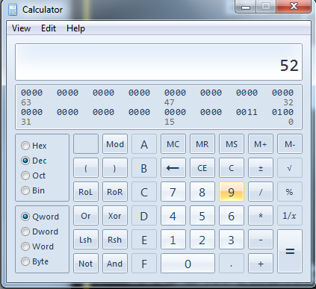
Stuff

Slide 40
Stuff

Slide 41
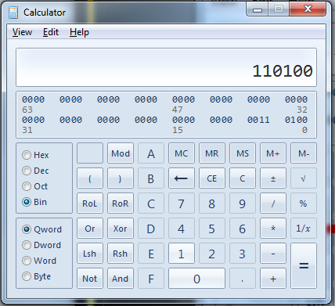

Slide 42
Let’s start to convert
3 rules for decimal-binary
Always write out the powers of 2 number line
x₁₀ to x₂ is subtracting
x₂ to x₁₀ is adding
We’ll use only 1s and 0s, they go
under the number line

Slide 43
Example 10111₂ to ?₁₀
1 0 1 1 1
The 1s and zeros go below
We are adding
Add all the 1s (yes, I cans)

Slide 44
Example 10111₂ to ?₁₀
1 0 1 1 1
The 1s and zeros go below
We are adding
Add all the 1s (yes, I cans)
16+4+2+1=23… back to calc!

Slide 45
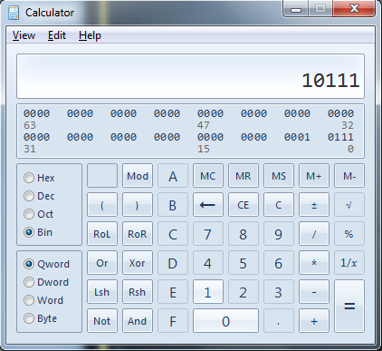
Stuff

Slide 46
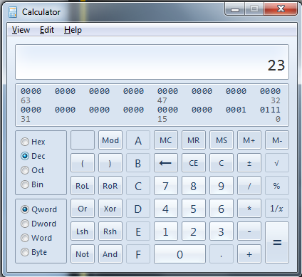
Stuff

Slide 47
But what about Hex?
what
about
hex?
Instant

Slide 48
Hex seems BAD
Hey, BAD is a hex number!
Just look up B, and A, and D

Slide 49
So
B is 1011
A is 1010
D is 1011
BAD₁₆=
101110101011₂

Slide 50
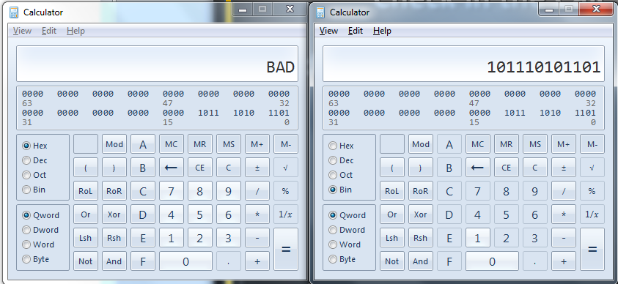
Check in the Calc
You can go from binary to decimal
or decimal to binary now, right?

Slide 51
Experiment with colors
<html>
<head><title>My First Web Page</title></head>
<body
bgcolor="white"
text="black">
<h2>Hi</h2>
</body>
</html>
For now, 00 means none, FF means full, a lot

Slide 52
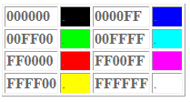

Slide 53
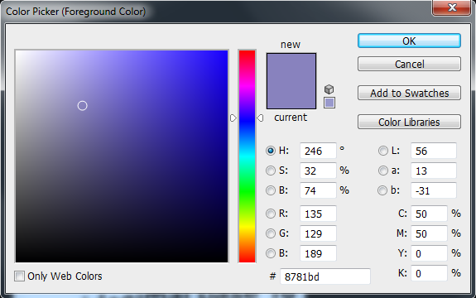

Slide 54
Related material
You Tube on web pages
  http://www.youtube.com/watch?v=Dx__92GizG4
YouTube on Paint
  http://www.youtube.com/watch?v=Ds1Qtfggt2w
YouTube on Numbers
  http://www.youtube.com/watch?v=HJbOG39lxuU
YouTube on Calc
  http://www.youtube.com/watch?v=UzYESAsNYY0
YouTube on Photoshop
  http://www.youtube.com/watch?v=rWO_DEH4KKI

