Slide 1
INSTRUCTIONALLY
APPROPRIATE TECHNOLOGY
INTEGRATION (IATI)
FRAMEWORK
Presented by Debbie Gilmore
Department Chair, INRW, Learning Frameworks (EDUC/PSYC1300), STSK
August 18, 2016

Slide 2
Faculty Learning Objectives
Faculty will:
Explore components of the IATI framework.
Collaborate, reflect, and share the four levels of the IATI framework.
Consider content and pedagogy to make decisions regarding the use of technology in the classroom.

Slide 3
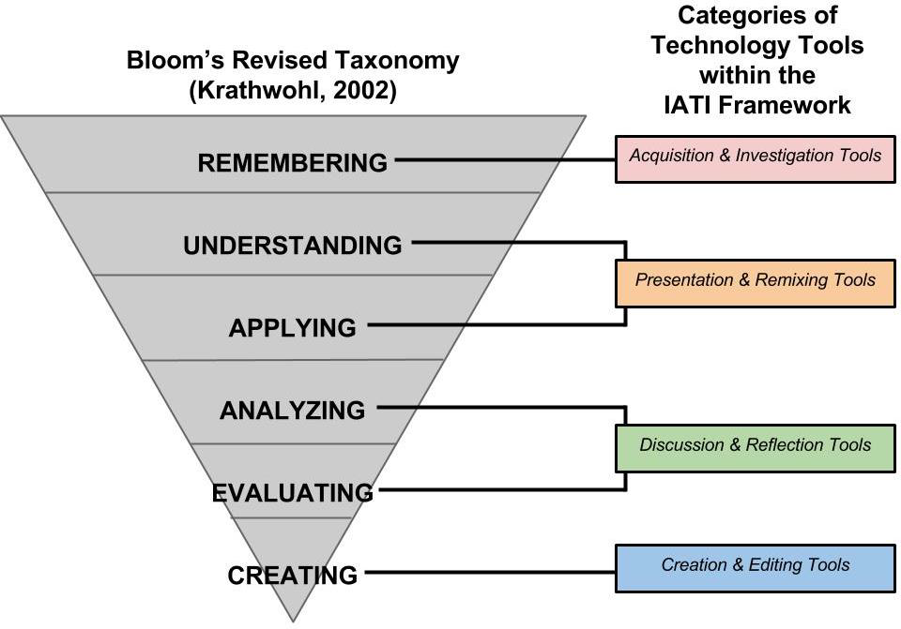
IATI Framework

Slide 4
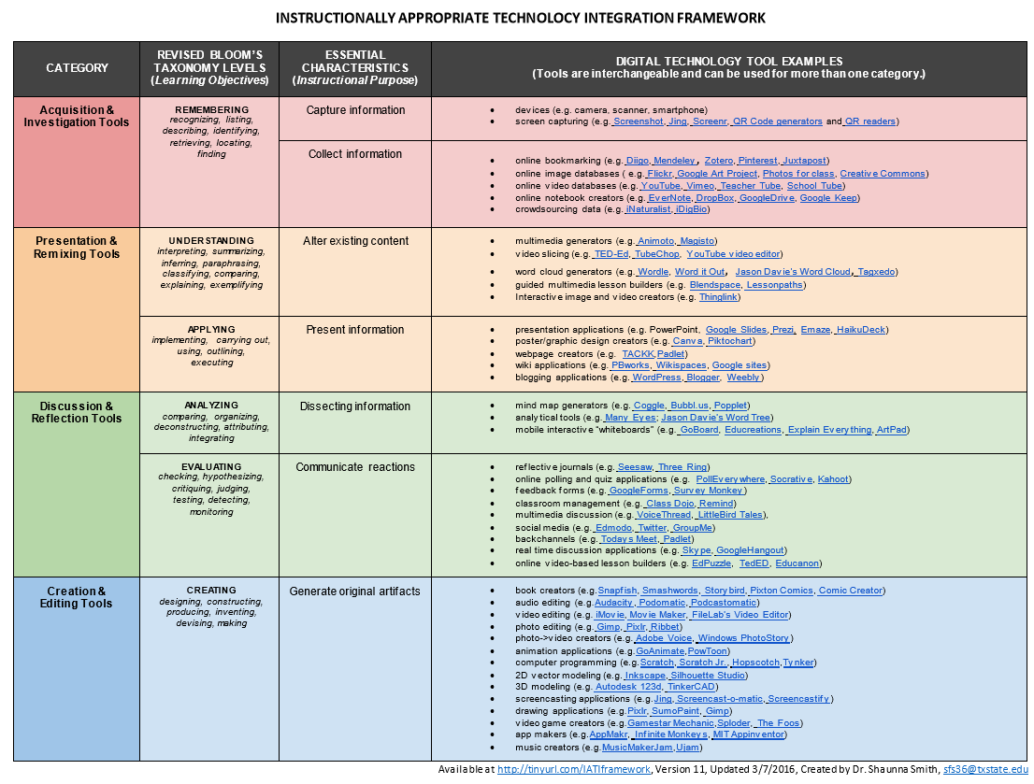

Slide 5
Moving from Theory to Practice
Groups:
  Acquisition and Investigation
  Presentation and Remixing
  Discussion and Reflection
  Creation and Editing
We will split into 4 groups.
Each group will work together to complete the reflection questions in the group packet. You will have about 10 minutes to work.
Choose a group spokesperson to share out one idea from the group with all the participants.

Slide 6
IATI Framework

Slide 7




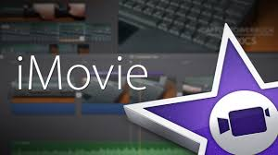
Fun and Easy Tech Tools

Slide 8
Wrap - Up
WHAT?
  Content
  Student Learning Objectives
  Textbook
HOW?
  Pedagogy
    Lecture
    PowerPoint
    Video
    Group Work

Slide 9
Where Does Technology Fit?
Using technology in the classroom serves 3 purposes:
  To replace
  To amplify
  To transform

Slide 10
Faculty Learning Objectives
Faculty will:
Explore components of the IATI framework.
Collaborate, reflect, and share the four levels of the IATI framework.
Consider content and pedagogy to make decisions regarding the use of technology in the classroom.

