Slide 1
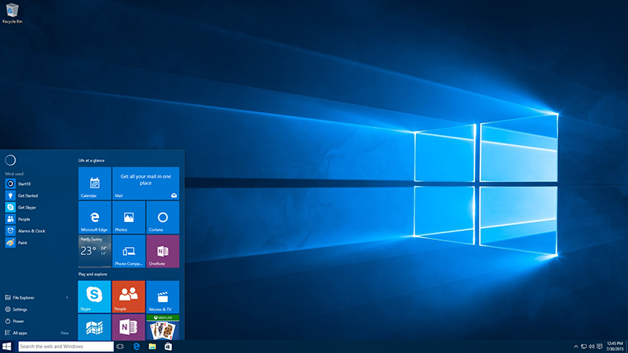
Windows Crash Course
Windows 10
R. Craig Collins ©2015

Slide 2
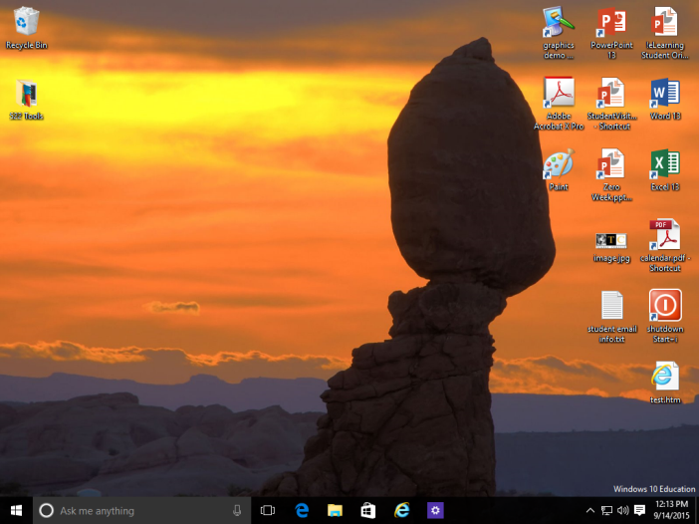
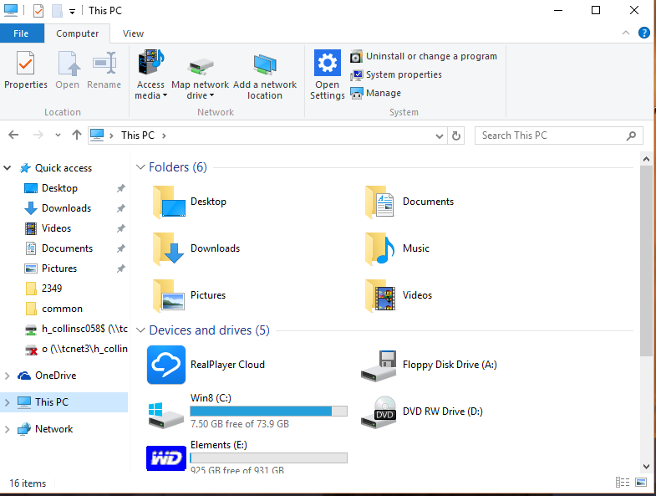
Windows 10 Crash course: overview
Desktop
Start Menu/Search
Action Center
This PC: Change icon size
This PC: Don’t hide extensions
This PC: Map Network Drive
This PC: Zipping files
Control Panel/Settings
This presentation assumes you have some basic experience with Windows 7...

Slide 3

Windows 10 Crash course: Desktop
Start Menu
Cortana
Task View
Quick Launch
Task Bar
System Notification Area
Desktop Peek
Action Center
A description of each topic follows, and includes a video tour of the Desktop

Slide 4
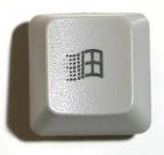
Windows 10 Crash course: Start Menu
Left Click Start Menu to browse apps
Right Click Start Menu for tools
Click Start icon and start typing to Search
You may right click an item to Pin to the Start Menu
Click All Apps to scroll through installed programs
A video of using the Start key, Start icon, and Start menu are available

Slide 5
Windows 10 Crash course: Cortana
If your computer has a microphone and speakers,
you may click on the Cortana microphone icon and simply say what you are searching for
Try “What’s the temperature”
or
“Tell me a joke”
A video of Cortana is available

Slide 6
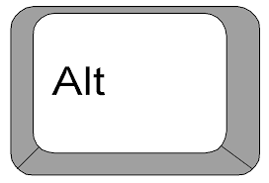
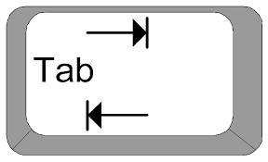
Windows 10 Crash course: Task View
In addition to using
to scroll through
open windows,
you can click the Task View icon
Video of Task View is available

Slide 7
Windows 10 Crash course: Quick Launch
Right click an item to “Pin” it to the Start Menu or the Task Bar
Items “Pinned” to Task Bar
show up in the Quick Launch area
to the right of the Task View icon
“Pinning” too many items to the task bar can crowd the display of programs that are running

Slide 8
Windows 10 Crash course: Task Bar
To the right of the Quick Launch area is the part of that Task Bar that shows you what programs you have started.
You can use the Task View icon to see thumbnail views of the Windows if the icons on the task bar are not giving you enough information.
Running programs
Again, having too many items “Pinned” leaves less room for icons of running programs

Slide 9
Windows 10 Crash course: Notifications
The System Notification Area, or the Tray,
indicates what programs Windows has started.
If there are several running, not all may display…
but the ^ icon to the left of the tray
will open a larger window.
  (Arrows mean ‘more options’ in Windows)
A video of expanding the System Notification area is available

Slide 10
Windows 10 Crash course: Desktop peek
To the extreme right size of the Task bar is a rectangular box shaped hot spot
pointing at that box will let you ‘peek’
at the desktop
Clicking that box will minimize all windows
and switch to the desktop
Note: click the time and date for big clock/calendar
Desktop Peek will not work if you are already looking at the desktop, or if no apps are running

Slide 11
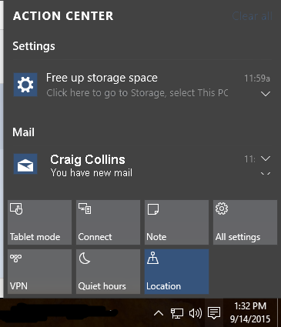
Windows 10 Crash course: Action center
Click the Action Center icon to the left of the clock
From here you get:
Alerts, such as updates
Notifications, such as new email
To quickly access settings
or, to go into Tablet mode
Table mode uses touch screen gestures rather than a keyboard and mouse

Slide 12
Windows 10 Crash course: This pc
In Windows XP, the tool to browse files was called
My Computer, or Windows Explorer
In Windows 7, the tool to browse files was called
Computer, or Windows Explorer
Starting in Windows 10, the same tool was called
This PC or File Explorer, the next section will cover:
  How to Change Icon Viewing Size
  How to stop hiding extensions
  How to View Properties
  How to Zip (Compress) Files
A description of each topic follows, and a video tour of the This PC is available

Slide 13
Windows 10 Crash course: This pc
To Change Icon Viewing Size to List view or Icon view
In Windows 7, the View icons button was top right when viewing My Computer.

Slide 14
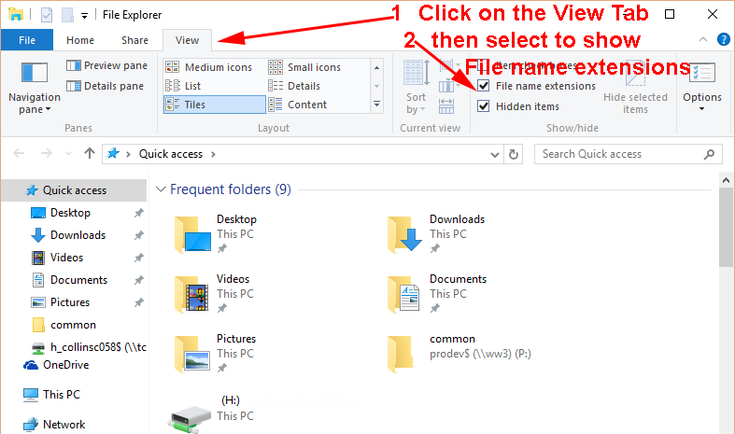
Windows 10 Crash course: this pc
Stop hiding Extensions
To quickly open the View tab, you can also press [Alt] + V

Slide 15
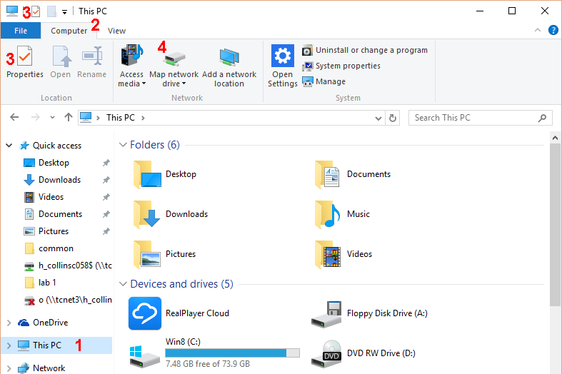
Windows 10 Crash course: This PC
To Map a Network Drive or view Properties
Open “This PC” if not already open. If you don’t see the Computer tab
1) Click on “This PC”
on the left margin
2) Select the Computer Tab
3) Click either icon
for Properties
or
4) to map drive
Don’t use Map Network Drive unless you know it’s use, this just points out where to find it

Slide 16
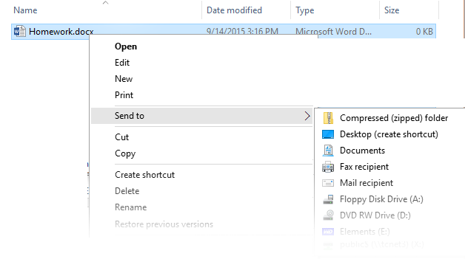
Windows 10 Crash course: This PC
Zipping Files
  Right click the file or folder you wish to zip
  Select Send To >
  Select Compressed (zipped) folder
Zipping files or folders allows you to create one small package that is easy to upload

Slide 17
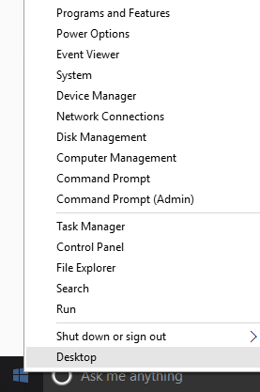
Windows 10 Crash course: Control Panel
Many items that used to be in Control Panel are now in Settings; the fastest way to get to Settings is to click the Action Center icon on the right side of the task bar
The fastest way to open the Control Panel:
Right Click the Start on the left of the task bar
For tablet users, press and hold the Start, or swipe from the right for the Action Center

Slide 18
Windows 10 Crash course: Review
Desktop
Start Menu/Search
Action Center
This PC: Change icon size
This PC: Don’t hide extensions
This PC: Map Network Drive
This PC: Zipping files
Control Panel/Settings
Thanks for reading

