Slide 1
Preparing for Tenure
Temple College
R. Craig Collins
Professional Development Coordinator

Slide 2
What is covered in this presentation
When do I start?
Timeline
Procedure
What to collect
How to assemble the packet

Slide 3
When do I start?
Your very first semester
Save EVERYTHING
  Teaching philosophy
  First day handouts
  Assignments
  Student feedback, etc.

Slide 4
Timeline
  Beginning with appointment to the rank of full-time/tenure-track faculty member, the pre-tenure period for a faculty member shall be ten (10) long consecutive semesters of full-time service (fall and spring semesters) at Temple College.

Slide 5
Timeline
The faculty member will begin the application process in the first two weeks of the 9th long semester of service. The application process will include:
  *Completion and submission of the Application for Tenure form.
  Submission of a Teaching Portfolio (electronic or hard copy) which should include (at a minimum):

Slide 6
What to collect
    *Philosophy: The faculty member’s personal philosophy of teaching.
    *Documentation of Teaching:
      *A summary of courses taught with a description of responsibilities
      *Examples of First Day Handouts/ Course Outlines/Syllabi
      *Examples of Assignments, Visual Aids (PowerPoint slides), etc.
      *Examples of Evaluation of Learning (quizzes, exams, etc.)
      Examples of Written/Electronic Feedback to learners
    *Measures of Teaching Effectiveness
      *Summary of learner evaluations of teaching
      *Annual departmental evaluations
      Teaching observations
      Learner aggregate scores on exams, standardized testing, etc.
    *Activities to Improve Teaching:
      Improvement plan with goals and activities to reach said goals
      New activities or methods of teaching developed, utilized, or implemented
      *Professional Development activities
    *Contributions to the Institution/Community:
      *Service on Department, Division, and/ or College committees
      *Service on Faculty Council committees
      Service to the community
    Professional Activities:
      Professional Memberships
      Presentations / Performances
      Publications
      Research
      Grants
    Honors and Awards
NOTE: (Required areas are denoted with a “*”. Other areas may be included for additional information.

Slide 7
What to collect
NOTE: (Required areas are denoted with “*”.
Other areas may be included for additional information. Information should reflect the faculty member’s contributions to the institution.)
*Philosophy:
The faculty member’s personal philosophy of teaching

Slide 8
What to collect
*Documentation of Teaching:
  *A summary of courses taught with a description of responsibilities
  *Examples of First Day Handouts/ Course Outlines/Syllabi
  *Examples of Assignments, Visual Aids (PowerPoint slides), etc.
  *Examples of Evaluation of Learning (quizzes, exams, etc.)
  Examples of Written/Electronic Feedback to learners

Slide 9
What to collect
*Measures of Teaching Effectiveness
  *Summary of learner evaluations of teaching
  *Annual departmental evaluations
  Teaching observations
  Learner aggregate scores on exams, standardized testing, etc.

Slide 10
What to collect
*Activities to Improve Teaching:
  Improvement plan with goals and activities to reach said goals
  New activities or methods of teaching developed, utilized, or implemented
  *Professional Development activities

Slide 11
What to collect
*Contributions to the Institution/Community:
  *Service on Department, Division, and/ or College committees
  *Service on Faculty Council committees
  Service to the community

Slide 12
What to collect
Professional Activities:
  Professional Memberships
  Presentations / Performances
  Publications
  Research
  Grants

Slide 13
What to collect
Honors and Awards

Slide 14
Procedure
The application and portfolio will be submitted to the faculty member’s Department Chair.
The Department Chair will have thirty (30) calendar days to review the materials and make a recommendation regarding tenure approval to the Division Director.
The Division Director will have thirty (30) calendar days to review the materials and make a recommendation regarding tenure approval to the Vice President for Educational Services.
The Vice President for Educational Services will have thirty (30) calendar days to review the materials and make a recommendation regarding tenure approval to the President.
By the end of the 9th long semester the faculty member shall be notified that their application for tenure has been accepted for consideration by the President or if their pre-tenure period has been extended.
The President will make a recommendation regarding tenure to the Board of Trustees.
Tenure can only be granted by official action of the Board of Trustees.
The President’s Office shall invite the faculty member to the Board of Trustees meeting at which official action will occur.

Slide 15
How to assemble the packet
Create a folder structure to save documents
Save first day handouts, assignments, examples of feedback, student evaluations in the appropriate folders

Slide 16
How to assemble the packet
Create cover pages for each section in Word
Convert all files to pdf
Name files using section numbers
  Example:
    02 Documentation of Teaching Coversheet
    02a Summary of courses taught
    02b Example of First Day Handout

Slide 17
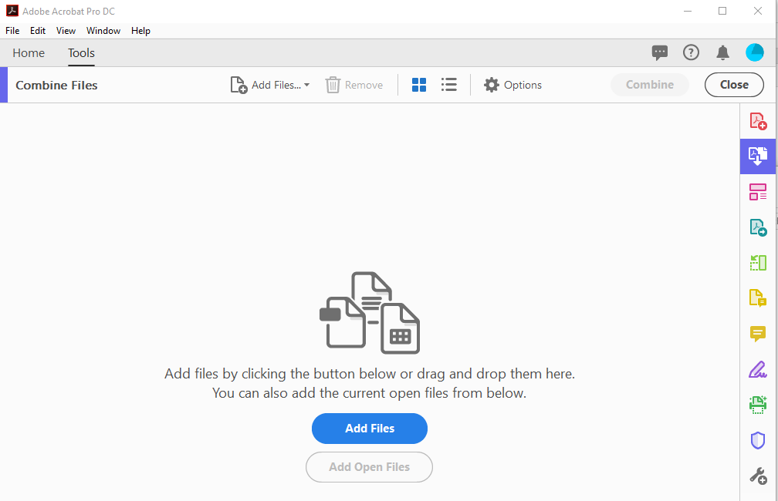
How to assemble the packet
Use Adobe Acrobat Pro
(not reader)
to combine all of
your files

Slide 18
Recap
When do I start? Now
Timeline: Submit in 9th long semester
Review Procedure
What to collect: EVERYTHING
Assemble the packet

