Slide 1
Temple College
TurnItIn.com Plagiarism Detection
Temple College
Continuous Orientation
Notes:
Temple College TurnItIn.com Plagiarism-Detection

Slide 2

Working on a paper?
Notes:
Are You Working on a Writing Assignment?

Slide 3
Be Honest
Did you know that Temple College uses TurnItIn.com plagiarism-detection software?
Notes:
Be Careful About Citing Sources and Using Quotation Marks. Did you know that Temple College uses TurnItIn.com plagiarism-detection software?

Slide 4

.
TurnItIn software matches your paper against databases of other papers and sources.
TurnItIn constantly searches the Internet!
Notes:
TurnItIn software matches your paper against databases of other papers and sources. TurnItIn constantly searches the Internet!

Slide 5
.
Your paper is matched against:
  Internet content.
  All documents ever turned in to TurnItIn.com.
  Online databases such as Academic Search Complete, which can be accessed through the Temple College Library website.
Notes:
Your paper is matched against many sources:
Internet content.
All work ever turned in to TurnItIn.com.
Online databases, such as Academic Search Complete, accessed through the Temple College Library website.

Slide 6
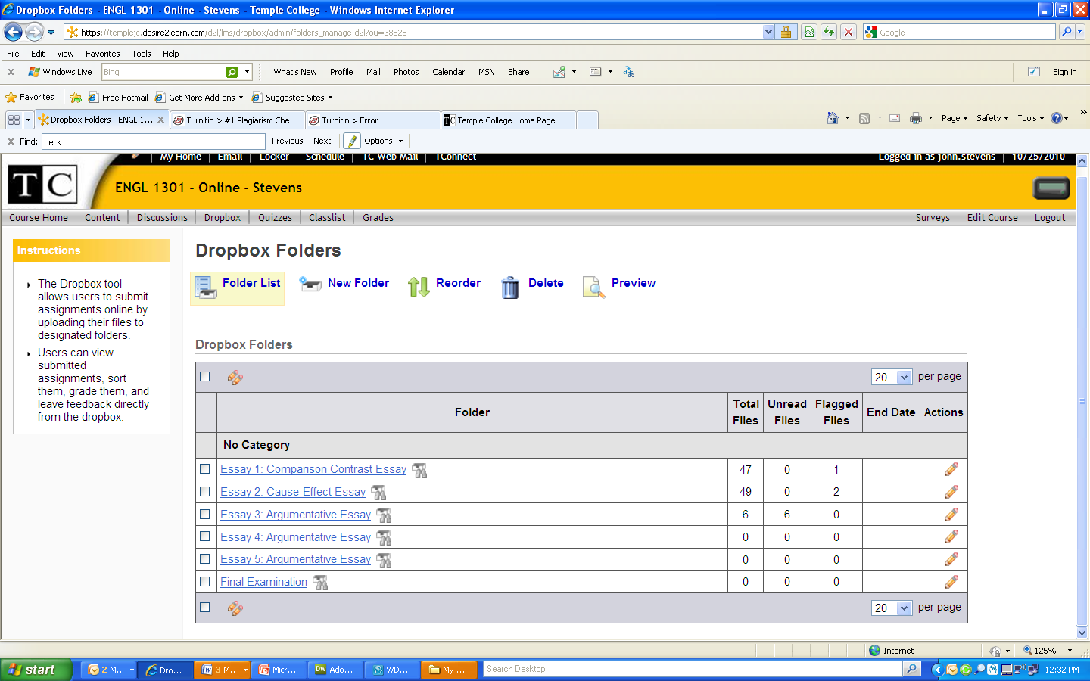
.
Instructors may simply have you upload your work to the D2L Dropbox, which is enabled with the TurnItIn plagiarism-detection software.
Notes:
Instructors send you to the dropbox to upload your work, and TurnItIn software checks for originality

Slide 7
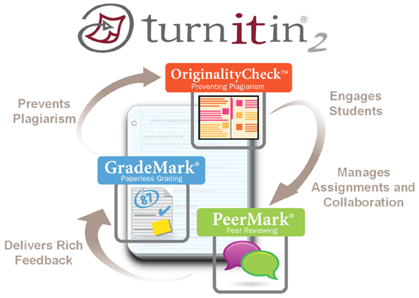
.
Instructors may send you directly to the TurnItIn.com website to upload your work.

Slide 8
What do you get after submission?
You will receive an e-mail confirmation to your Temple College email account informing you of a successful submission.
Notes:
What do you get after you submit your work? You will receive an e-mail confirmation to your Temple College email account, informing you of a successful submission.

Slide 9

Do Not Be Afraid!
Here is the best advice you will ever receive about writing papers:
If the words are not your own, put them inside quotation marks.
Notes:
Here is the best advice you will ever receive about writing papers:
If the words are not your own, put them inside quotation marks.

Slide 10
Conclusion
Follow these three simple steps:
If the words are not your own, put them inside of quotation marks.
Document your source with an in-text citation.
Document your source on the Works Cited page.
Notes:
Follow these three simple steps:
If the words are not your own, put them inside of quotation marks.
Document your source with an in-text citation.
Document your source on the Works Cited or References page.

Slide 11
For More Information
If you have an issue that requires tech support, contact TurnItIn directly here.
https://www.turnitin.com/self-service/support-wizard.html
Notes:
If you have an issue that requires tech support, contact TurnItIn directly

