Slide 1
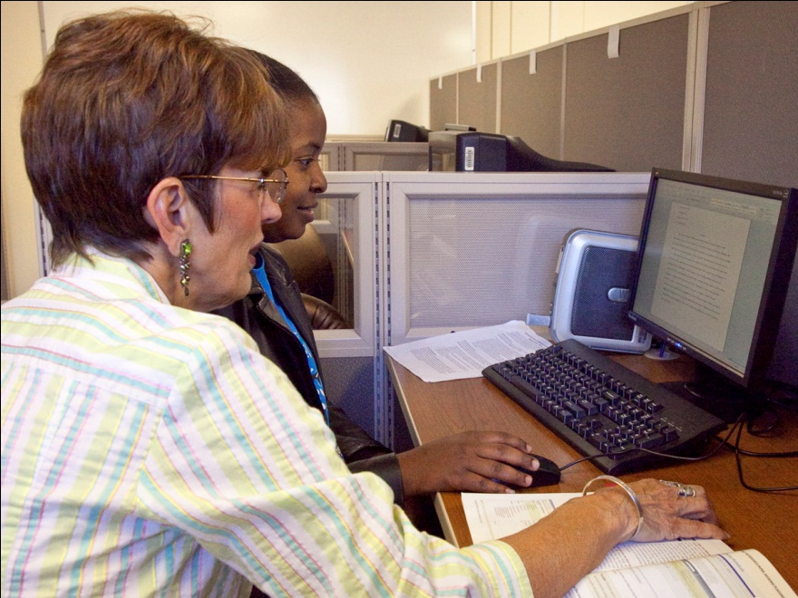
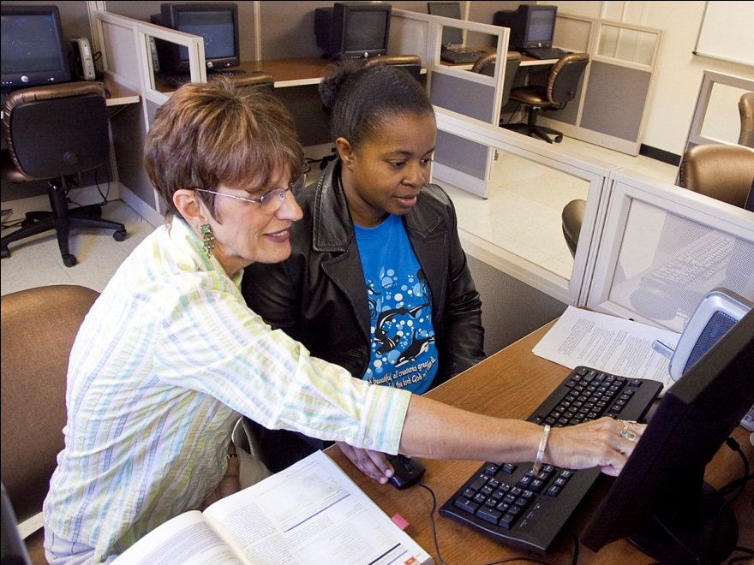
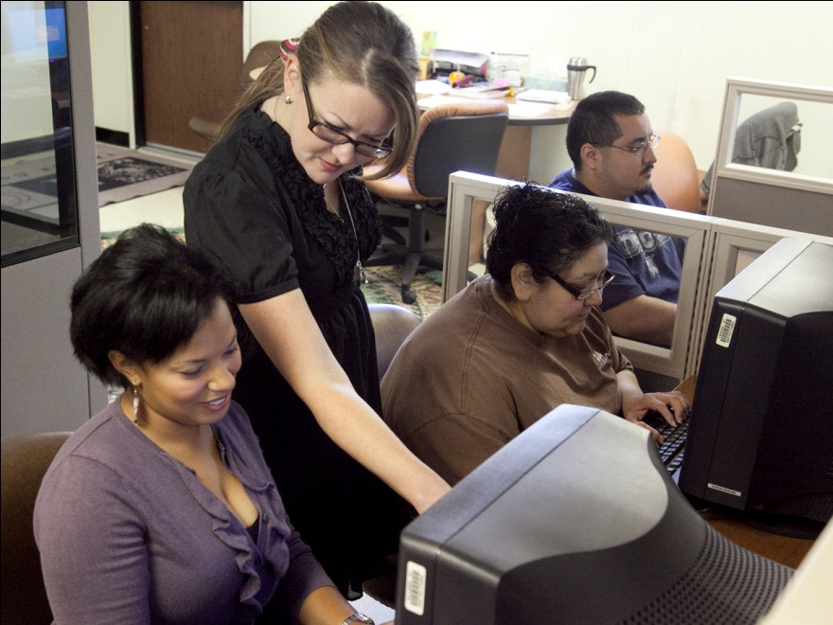
Temple College Writing Center
Temple College
Continuous Orientation
Notes:
The Temple College Writing Center

Slide 2
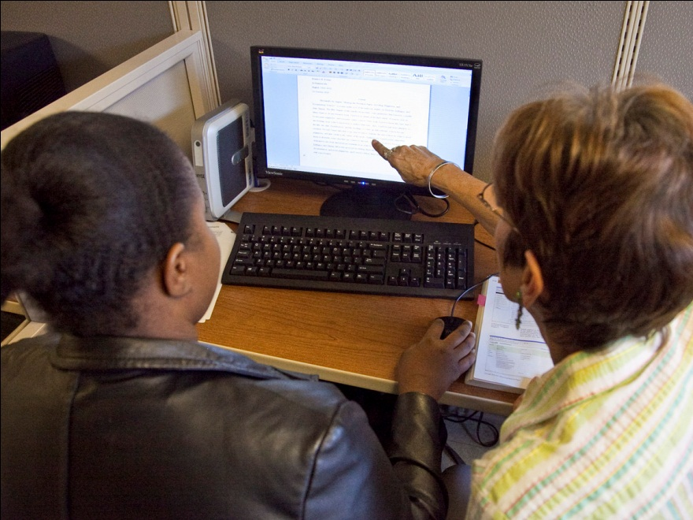
Help for any writing stage
Planning
Prewriting
Drafting
Revising
Notes:
The Temple College Writing Center can provide help for any writing stage. Pre-writing- coming up with a great topic or research idea.
Planning, creating an organizational plan for the project. Drafting, guiding students during the drafting process and revising answering
specific questions about the students paper.

Slide 3
Writing Center Services
Face-to-Face consultations
    Walk-in or by appointment
    Typically ½ hour
    Discuss ways to improve writing skills
    Proper APA or MLA documentation and formatting
Paper feedback via email
Notes:
The Writing Center can provide face-to-face consultations. Walk in or make an appointment. They typically last about a half an hour and they can discuss ways to improve writing skills, the proper use of APA or MLA documentation and formatting, and they also have the ability to give you paper feedback via email.

Slide 4

Writing Center Services cont.
Targeted writing workshops
Practice final examination for English Composition I
Writing lab with computers and printer
“Writing is an exploration. You start
from nothing and learn as you go.”
~E. L. Doctorow
Notes:
The Writing Center also provides targeted writing workshops to help you become a better writer. You can take practice final examinations for English Composition one, and they have writing
labs with computers and printers.

Slide 5
What to Bring
Specific goals to accomplish
Ideas and questions
Syllabus or assignment requirements
Something to write with and write on
Textbook and reference materials
Notes:
So when you're ready to use the Writing Lab, make sure you bring specific goals that you want to accomplish. Bring ideas and questions. Bring your syllabus or the assignment that you're required something to write on and something to write with. Textbooks and reference materials can also be helpful.

Slide 6
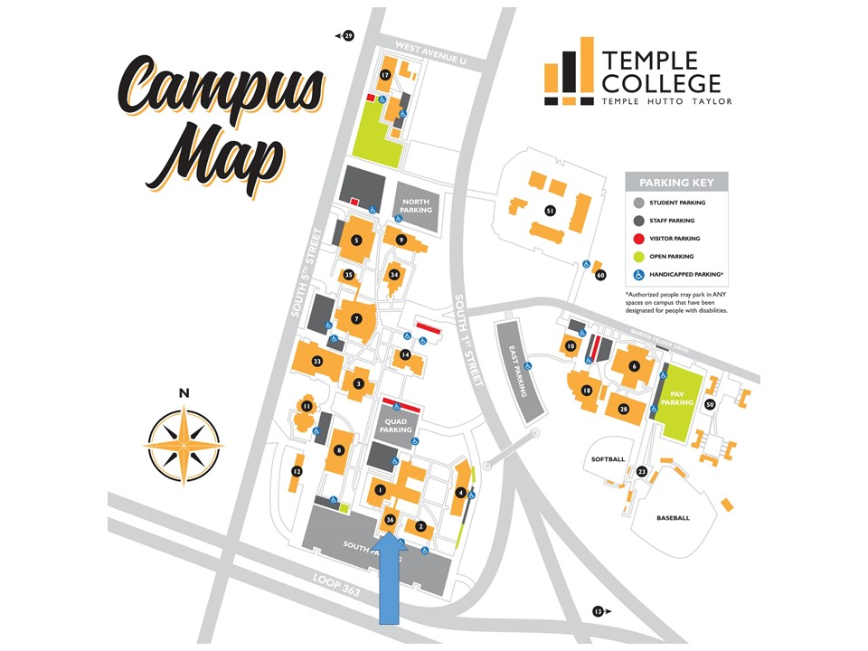
SSC
Room 3612
Hours of Operation Fall and Spring
M - TH 8 a.m. - 7 p.m., Friday 8 a.m. – noon
Summer hours, Mon. – Thur. 8 a.m. – 6 p.m.
Phone: 254-298-8393
Email: writingcenter@templejc.edu
Notes:
The Writing Lab can be found at the new Student Success Center room 3612. That's right across the hallway from the Testing Center. The hours of operation in the Fall and Spring are Monday through Thursday 8 a.m. to 7 p.m. Friday 8 a.m. to noon. Summer hours are Monday through Thursday 8 a.m. to 6 p.m. You can contact them by
phone at 254-298-8393 or by emailing writingcenter@templejc.edu

