Slide 1
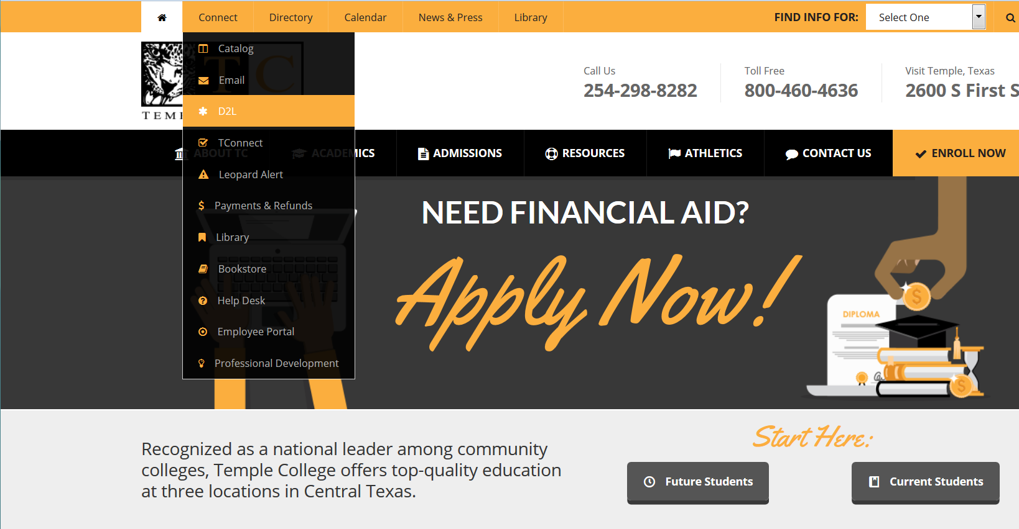
Accessing Desire2Learn (D2L) (1 of 6)
From www.templejc.edu place your cursor over “Connect” and click on “D2L”. New D2L students will not have access to D2L until 6:00am the first-day of the semester.

Slide 2
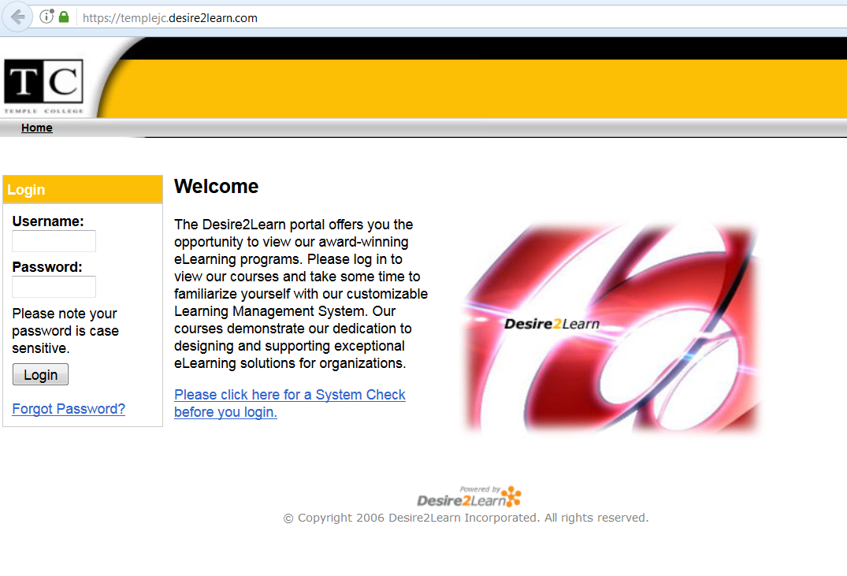
Accessing Desire2Learn (D2L) (2 of 6)
Type your username and password. Username: lastname+first initial+last 3
numbers of your student ID; Password: for first-time D2L students it is the same as your username; for returning students it is the password you previously set.

Slide 3
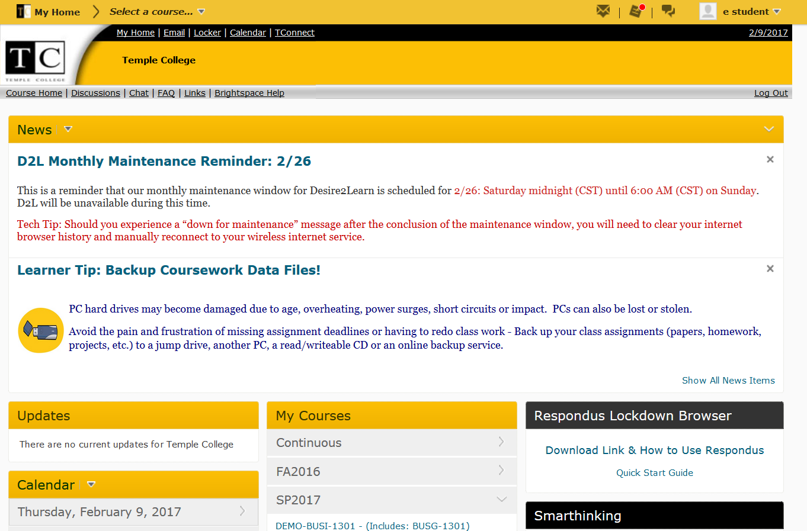
Accessing Desire2Learn (D2L) (3 of 6)
You will see your D2L homepage. Your semester courses will be viewable by clicking on the grey arrow in the middle column under “My Courses”. Click on each course to view the course homepage and navigate through the course.

Slide 4
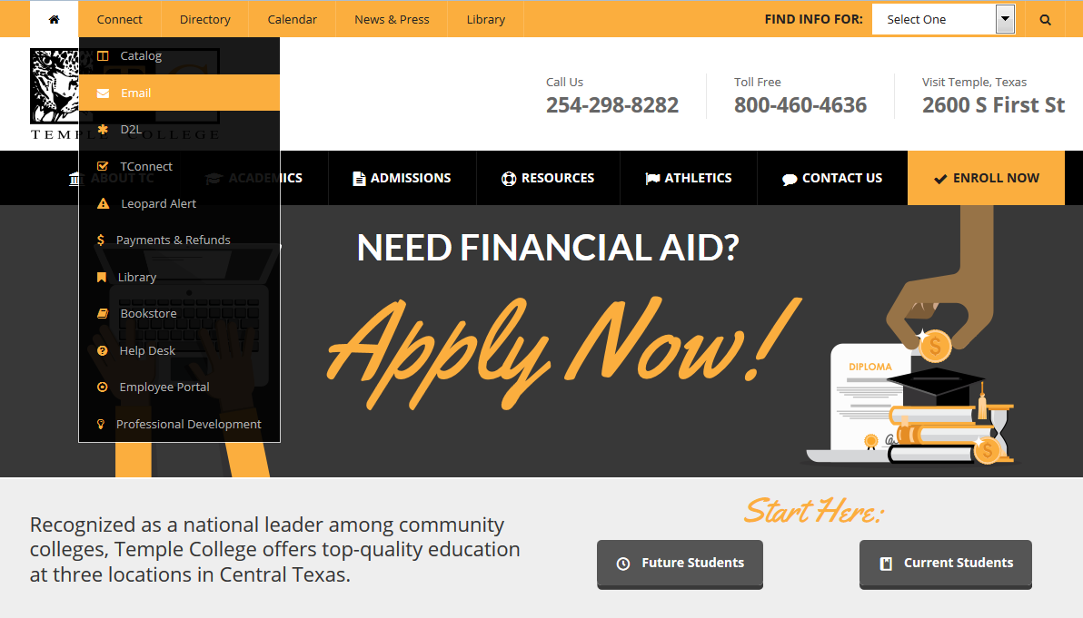
Accessing Office 365 email (4 of 6)
From www.templejc.edu place your cursor over “Connect” and click on “Email”.

Slide 5
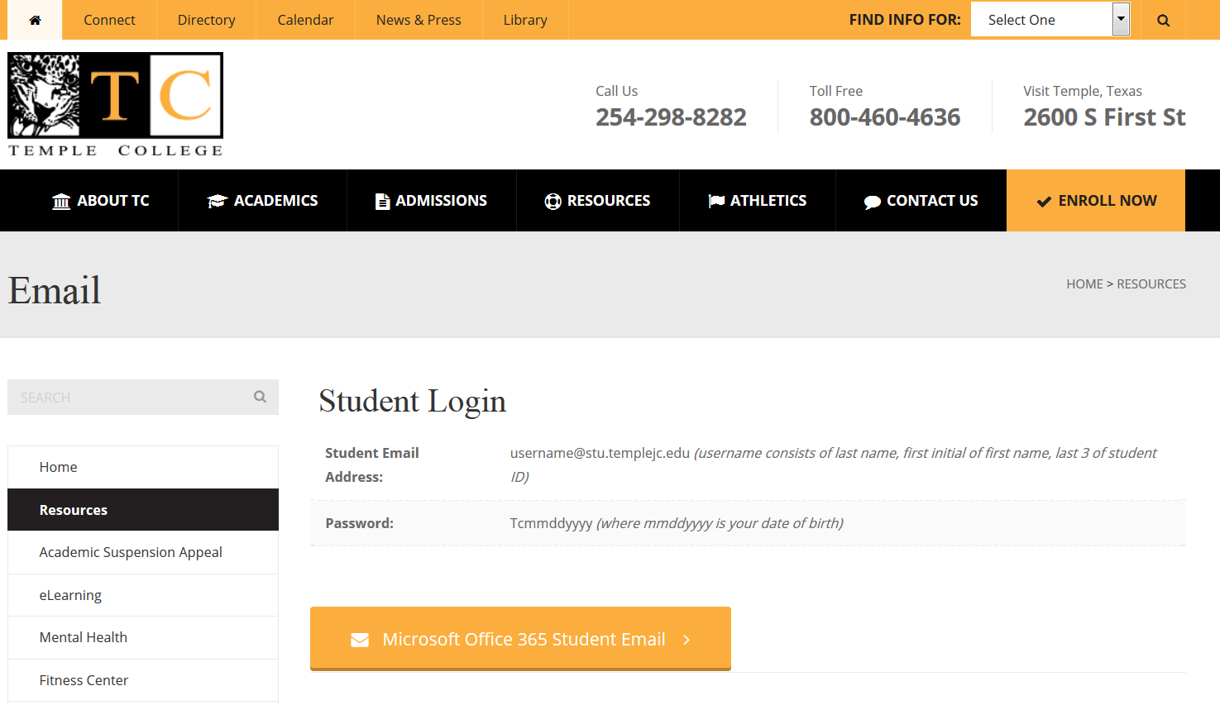
Accessing Office 365 email (5 of 6)
Review the username and password formats and then click on the “Microsoft Office 365 Student Email” button.

Slide 6
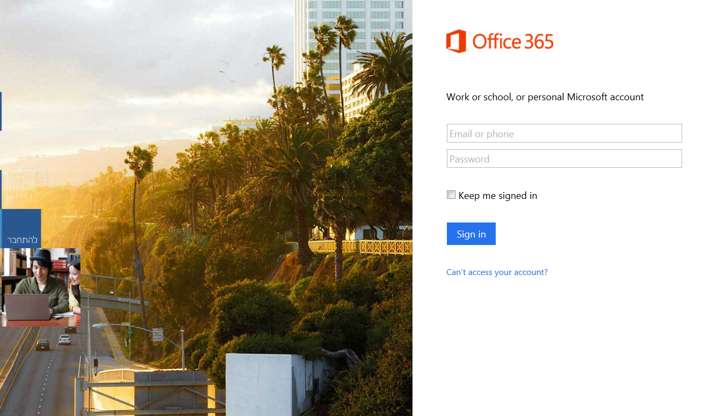
Accessing Office 365 email (4 of 6)
Type your TC email address (lastname+first initial+last 3) and your password (Tcmmddyyyy, where mmddyyyy is your date of birth). This is the ONLY email account used by Temple College personnel and instructors to notify you of important course and campus information. Be sure to check your “Inbox, Clutter and Junk Email” folders daily.

