Slide 1

Testing Center
Tutoring Services
Success Coaches
Open Computer Lab
Temple College
Continuous Orientation
Notes:
Let’s take a minute to discuss
The Testing Center, Tutoring, Success Coaches, and Computer labs on campus.

Slide 2
Testing Center

Slide 3
What Test Do You
Want to Take?
DSST
HESI
TEAS
FISDAP
ACCUPLACER
TC Class Exams
TSI Assessment
CLEP
Proctored Exams from Different Schools
Notes:
The Testing center is where you go to take standardized tests, and some instructors will have you take class exams in the testing center as well.

Slide 4

When Can I Test on Main Campus?
Any time the Testing Center is open
Testing is first-come first-serve
  No appointments needed for most exams
Monday-Thursday 8:00 a.m. – 8:00 p.m.
Friday 8:00 a.m. – Noon
Open occasional Saturdays. Check with Testing Center for dates.
Start your test early enough to finish before closing time
Some exams require that you be at the Testing Center before a certain time
    PLEASE NOTE: ALL tests must be completed by the posted closing time. ALL tests will be collected at closing time whether completed or not. TSI Assessment, HESI, and TEAS V tests are not administered on Friday.
Notes:
You can take a test anytime the Center is open, Monday – Thursday from 8:00 AM to 8:00 PM, and Friday 8:00 AM TO noon. Some occasional Saturday testing may be available.
No appointment needed. PLEASE CHECK OUR WEBSITE FOR DETAILED INFORMATION ABOUT OUR TESTING SCHEDULE.
You do need to start early enough to finish the test before closing time. No test can be started in the last 45 minutes of the business day.

Slide 5

Photo ID Required!
ALL students MUST have ID
  Student ID card, or
  Driver’s License, or
  Military ID
No Photo ID -- NO TEST
Notes:
A valid photo ID is required for all tests
No ID, no Test.

Slide 6
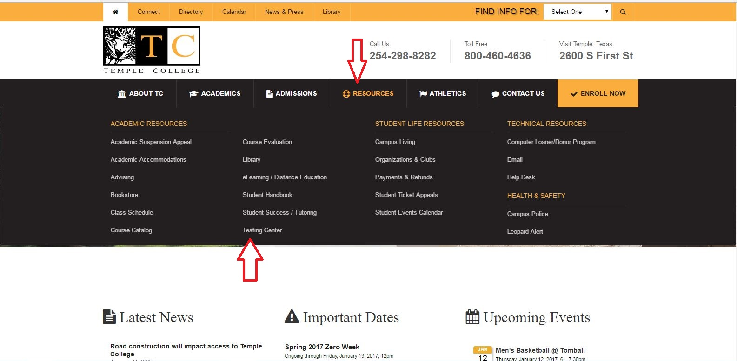
More Information
www.templejc.edu
Notes:
More information is available on the Testing Center Website, at www.templejc.edu. Scroll over admissions, or resources and click on testing center.

Slide 7
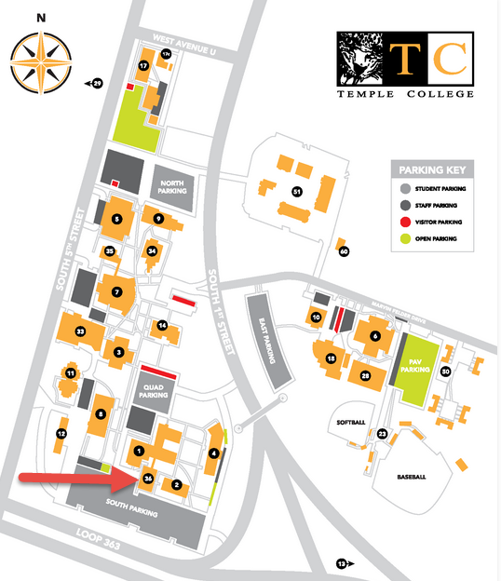
About the Testing Center
Hours
  Fall and Spring Semesters
    M-TH 8:00 a.m. – 8:00 p.m.
    Fri 8:00 a.m. – Noon
    Occasional Saturdays
  Summer Semester
    M-TH 7:30 a.m. - 8:00 p.m.
Phone Numbers
  Office - 254-298-8586
  Fax - 254-298-8228
Location
  Student Success Center RM 3613
Notes:
The Testing Center is located in
Student Success Center, SSDC, RM 3613.

Slide 8
Taylor & Hutto Testing
Taylor
  No testing center. Meet with instructor to schedule a time to take exam, or test at the Hutto of Main Campus Testing Center.
Hutto - First Floor By appointment only.
  Testing Center 512 – 759 – 5925
  Closed 12 p.m. – 1 p.m. Monday – Thursday.
    PLEASE NOTE: ALL tests must be completed by the posted closing time. ALL tests will be collected at closing time whether completed or not. TSI Assessment, HESI, and TEAS V tests are not administered on Friday.
Notes:
EWCHEC-Hutto testing is done by appointment only. Please call 512-759-5925 to schedule an appointment, or for more information about testing in Hutto.

Slide 9
Tutoring Services
Writing Center- Student Success Center RM 3612
  Fall & Spring: Monday – Thursday 8:00 am to 7: 00 pm, Friday 8:00 am to 12:00 pm
  Summer: Monday – Thursday 8:00 am to 6:00 pm
Math Tutoring- Student Success Center RM 3606
  Fall & Spring: Monday – Thursday 8:00 am to 7: 00 pm, Friday 8:00 am to 12:00 pm
  Summer: Monday – Thursday 8:00 am to 6:00 pm
Notes:
Temple College offers free tutoring for students. Located in the Student Success Center, the Writing Center and Math Tutoring Center can assist students with coursework that has been assigned in their classes. No appointment is needed for tutoring.

Slide 10
Student Success Coaches
Located in Arnold Student Union, 2nd floor and One College Centre, 2nd floor (across from advising). Call 254-298-8501, 254-298-8342, or 254-298-8366
Do you need assistance with:
Study Skills
Tutoring
Resources:
On/off campus
Staying on Track With Classes
Time Management
Notes:
The Student Success Coaches at Temple College are a valuable resource to students. Do you need assistance with finding tutoring, time management, study skills, staying on track, or information about available resources on and off campus? The Success Coaches are here to answer these questions and many more. You can find a Success Coach on the 2nd floor of the Arnold Student Union building, or the 2nd floor of One College Centre across from advising.

Slide 11

Open Computer Lab
Notes:
NOW LET'S DISCUSS THE OPEN COMPUTER LAB on campus

Slide 12
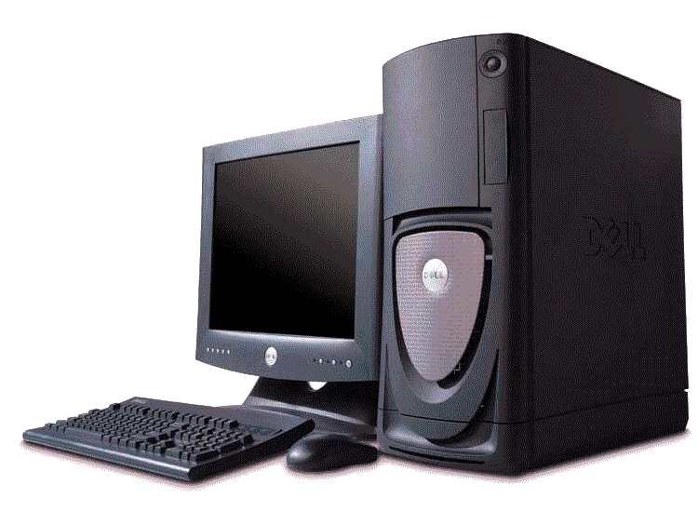

Open Computer Lab
If you don’t have access to a computer, there are two options to help you get your work done in
Watson Technical Center
(WTC)
Notes:
You do not have to use the testing center for most online tests, any Internet computer will do; but if you don’t have access to a computer, you have a couple of options to help you get your work done in the Watson Technical Center.

Slide 13
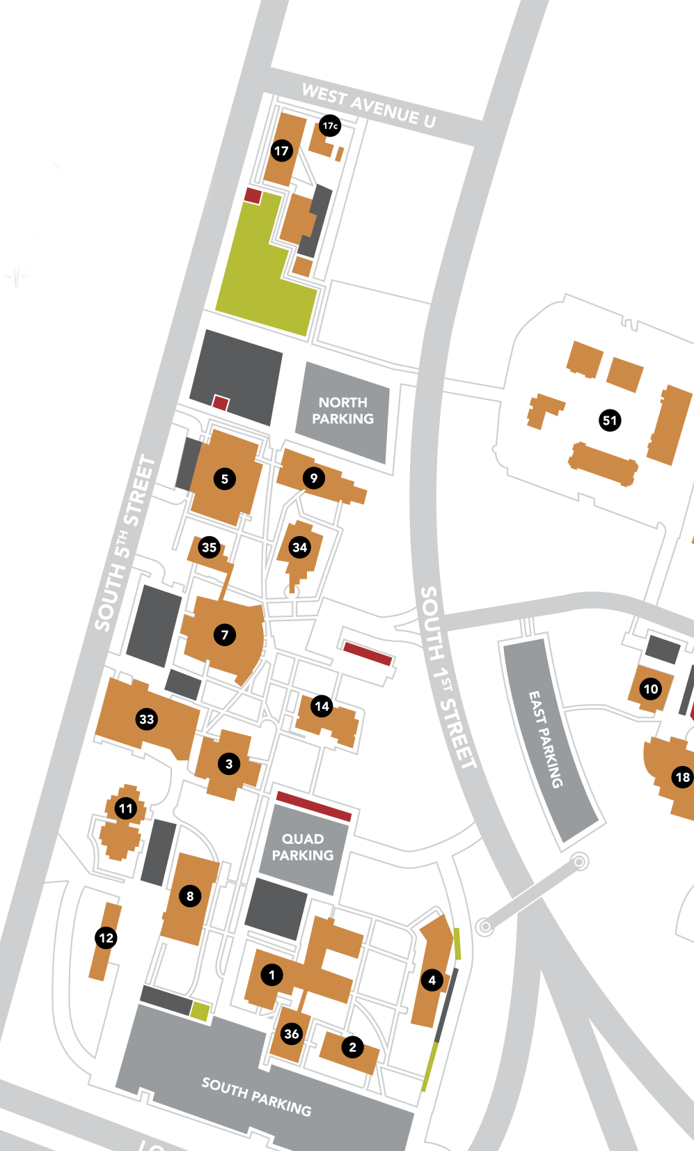
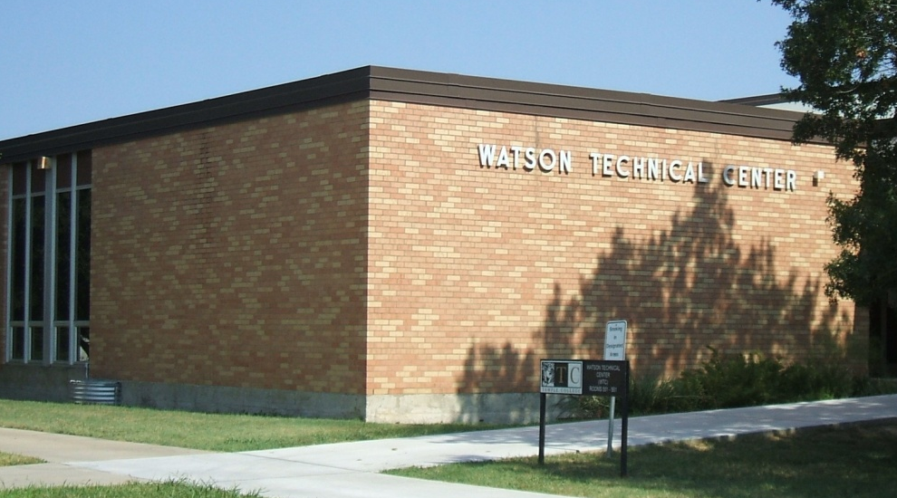
WTC
Watson
Technical Center
Notes:
The Watson Technical Center is north of One College Centre, between 1st and 5th Street, by the Administration building.

Slide 14
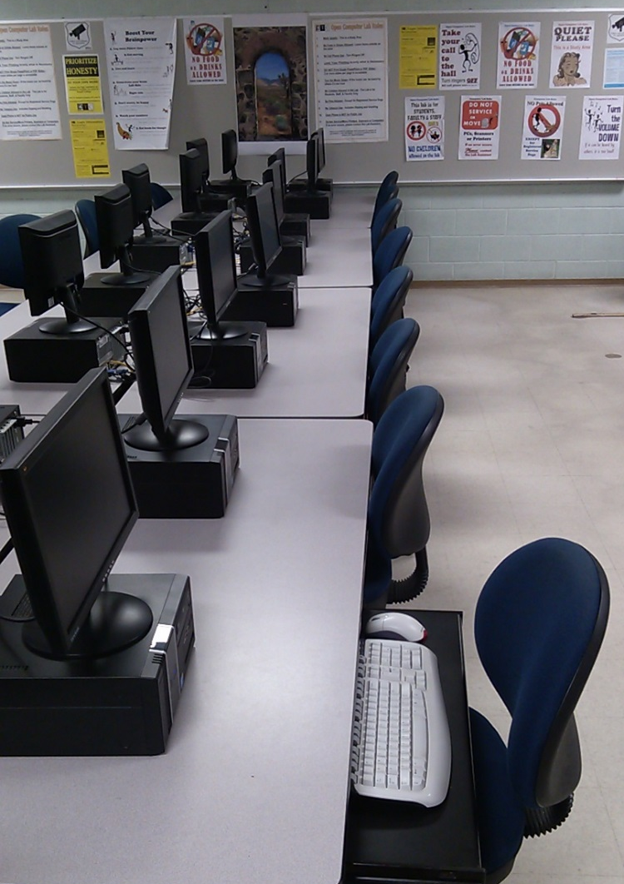
Open Computer Lab
WTC room 501
30+ computers
The computers have
  web browsers
  word processing software
  most of the software programs required for your class
  scanners are available in 501 WTC
  black/white printing can be done
  PLEASE NOTE: the copier for student use is located in the Hubert M. Dawson Library
Notes:
The Watson Technical Center Open Computer lab is located in room 501 and can be contacted at 254-298-8447. There are more than 30 computers available from early morning until late evening, Monday through Thursday, and Friday mornings during the Fall and Spring semesters.
OMIT FRIDAY SLOT DURING SUMMER

Slide 15
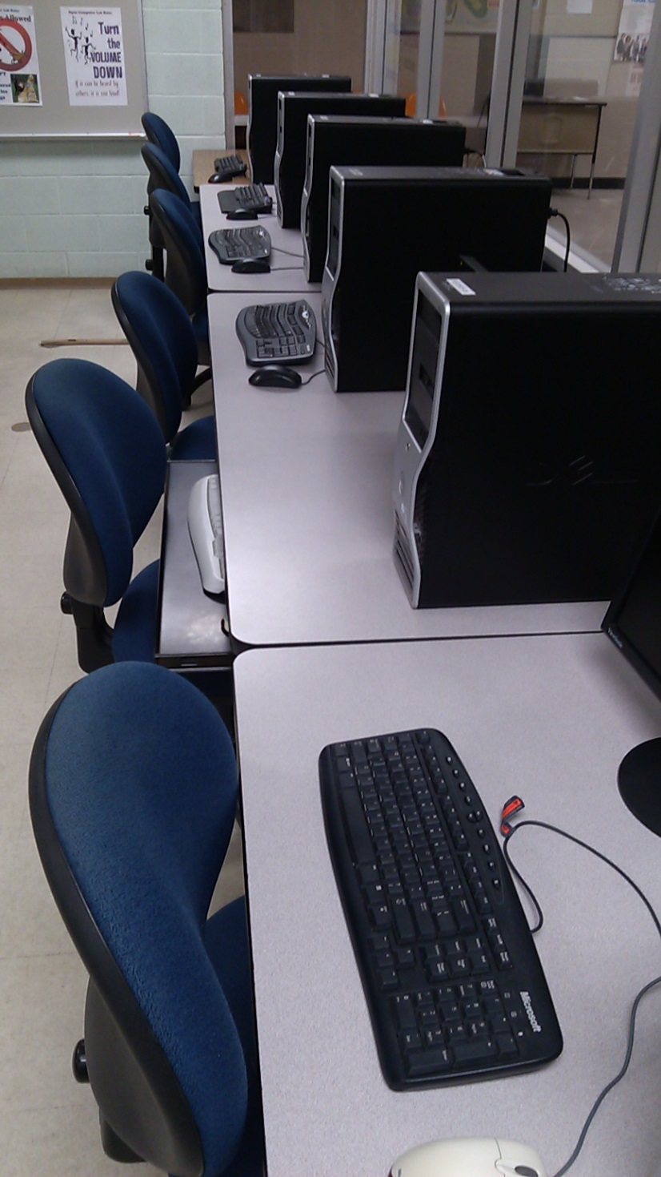
Open Computer Lab
Open early morning
until late evening
Monday through Thursday,
and Friday mornings
during the Fall and Spring semesters.
On Saturday and Sunday, the Hubert M. Dawson Library has computers available for student use.
Notes:
The computers have web browsers and word processing software, plus printers, scanners, and many of the software programs required for your class. There is also a computer lab in the library for Sunday use.

Slide 16
Taylor and Hutto
Check with the front desk for more info
  Taylor – RM 121 w/ printer, RM 112 w/ printer, and the front lobby has a few computers with printer access.
  Hutto – 1st floor open computer
  lab & the library also has a few
  computers to use.
  Loaner computers are also
  available from these
  campuses
Notes:
Taylor and Hutto students can check with the front desk for times that the computer labs are open for student use

