Slide 1
ADA - TRAINING: TITLE II – EDUCATIONAL ACCOMMODATIONS
Misty Reid
Coordinator of Student Accommodations
One College Centre
– RM 1469
misty.reid@templejc.edu
254-298-8335

Slide 2
THE AMERICANS WITH DISABILITY ACT AMENDED (ADAA) 2008
The ADAA is designed to remove barriers which prevent qualified individuals with disabilities from enjoying the same opportunities that are available to persons without disabilities.
All students with disabilities have the right to equal access of information that is presented to them. They should not have advantages given to them that other students do not have

Slide 3

SECTION 504 OF THE REHABILITATION ACT OF 1973
“No otherwise qualified person with a disability in the United States…shall, solely on the basis of disability, be denied access to, or the benefits of, or be subjected to discrimination under any program or activity provided by an institution receiving federal financial assistance.”
Under Section 504, institutions are required to appoint and maintain at least one person to coordinate its efforts to comply with the requirements of Section 504.
Office of Student Accommodations Coordinator
Misty Reid
254-298-8335
misty.reid@templejc.edu

Slide 4
OSA’S MISSION
Value each person on campus and their right to equal access to Temple College's programs and services
Assist instructors in providing an opportunity for students to be successful learners
Promote students' personal growth inside and outside of the classroom
Maintain legal compliance to all applicable laws

Slide 5
OSA COORDINATOR’S RESPONSIBILITY FOR ACCOMMODATIONS
Advocate for OSA students to determine what accommodations will give OSA students equal access to learning.
Provide only reasonable accommodations to OSA qualified students only.
Protect Temple College from Civil Rights complaints and potential discrimination law suits by students with disabilities.
Serve as a liaison between OSA students and instructors when needed.
Mediate discrimination complaints and recommend solutions for compliance.
Provide resource support for accommodation compliance to instructors

Slide 6
APPLICATION PROCESS
1.Student must self-disclose his or her disability to the OSA and request classroom accommodations
According to the Rehabilitation Act of 1973 and the Americans with Disabilities Act Amended (ADAA) 2008, a student with a disability is someone who has a physical or mental impairment; has a history of impairment; or is believed to have a disability that substantially limits a major life activity such as learning, speaking, seeing, hearing, breathing, walking, caring for one’s self, or performing manual tasks.

Slide 7
2. STUDENT MUST PROVIDE THE OSA WITH DOCUMENTATION OF DISABILITY.
Acceptable Documentation:
FIE(Full and Individual Evaluation) from High School
Temple College Disability Documentation Letter
Evaluation Report from qualified professional
Letter from qualified professional in which the professional provides:
Specific Diagnosis – based on a comprehensive assessment conducted by a qualified professional. Evidence of a substantial limitation to learning or other major life activity must be provided.
Medications and side effects.
Test Scores (if any)
Clinical Summary
Recommendations for Accommodations

Slide 8
3. DETERMINING REASONABLE ACCOMMODATIONS
“How does the disability/disorder affect your learning in the classroom?”
Accommodation Guidelines:
1. Accommodation must support the limitations of the disability.
2. Accommodation cannot modify the essential elements of the class as stated in the class syllabus.
3. Accommodations cannot provide an unfair advantage to the student with a disability.
4. Accommodations do not provide personal assistance outside of the classroom.
5. Accommodations are not retroactive.

Slide 9
FALL 2019 DISABILITY BREAKDOWN
96 students have requested accommodations for their fall classes
288 letters of accommodations will be delivered (emailed to instructors on 08/21/19)
Learning Disability – Dyslexia -23
ADD/ADHD – 21
Mood Disorders – – Depression, Bipolar, PTSD -17
Other – - Cerebral Palsy, Sensory Processing Disorder -3
Hearing Impairments- Deaf, Hard of Hearing 6
Visual Impairments – – Blindness or Limited sight 5
Illness – – Cancer, Meningitis -3
Orthopedic Impairments – 2
Psychotic – – Schizophrenia, Personality disorder -3
Pervasive Disabilities – – Autism Spectrum Disorder -11
Cognitive Disabilities- – Traumatic Brain Injury -2

Slide 10
STUDENT’S RESPONSIBILITY FOR ACCOMMODATIONS
1. Students must request letters of accommodation each semester.
2. Within 1-2 class days, students are advised to introduce themselves to their instructors, and clarify that the instructor has received their letter of accommodations and discuss any issues or concerns if any the instructor has with the accommodation requests.
3. Students must maintain continuous communication regarding their accommodations throughout the semester by scheduling for tests and making accommodation arrangements with their instructors.
4. Students are responsible for their own success.

Slide 11
FACULTY’S RESPONSIBILITY FOR ACCOMMODATIONS
You are obligated by law to utilize the Letters of Accommodations.
1. They will be emailed to you week before classes start (Wednesday of Welcome Week). If you don’t have a letter, the student either has not contacted me, or he/she does not qualify for accommodations in your class.
2. If a student claims to need accommodations, refer him/her to the OSA office.
Uphold and respect FERPA.
1. Do not discuss a student’s disability or accommodations in the classroom nor in front of other students.
2. Keep the student’s letter of accommodation secure.
3. Use only TC Email addresses when discussing accommodations with student via email.

Slide 12
BEST PRACTICES FOR ACCOMMODATION COMPLIANCE
Protect yourself from complaints and/or lawsuits by:
1.NEVER saying “NO” or “I cannot/will not provide this accommodation.”
2.Being flexible, thinking outside of the box, and being willing to change the environment by providing assistive technology devices, supports, and accommodations to ensure the student has equal access to all class materials.

Slide 13
BEST PRACTICES FOR ACCOMMODATION COMPLIANCE
3.Once you have received the accommodation letter for a student, ask questions and voice concerns first to students then to the OSA if solutions cannot be found.
4.Reviewing student accommodation requests before class and before each test.
5.Reporting suspected and/or known accommodation abuses to OSA

Slide 14
SUGGESTED IMPLEMENTATION OF ACCOMMODATIONS
Alternative testing location
Testing Center, Adjacent Classroom (if not on main campus Hutto/Taylor)
Provide a copy of lecture notes before class begins*
Power Points ; Outline of notes
Use of a tape recorder or laptop in class –
Recorded Lecture Agreement (OSA student will sign this)
Adobe Test Reader–
Send all tests to OSA for conversion (For on-campus classes ONLY)
Extended time on in-class assignments*

Slide 15
SUGGESTED IMPLEMENTATION OF ACCOMMODATIONS
Sign Language Interpreters
Allow student to sit in front of class. Interpreter will sit during lecture, but travel with you if you move while talking. Do not move student and interpreter to the back of the room.
Use of Note taker
Accommodation for students needing interpreter since they cannot watch the interpreter and take notes at the same time.
If you do not have detailed notes to provide the student, assign a fellow classmate to take notes. OSA has a copier that is free to use in order to copy notes for the OSA student

Slide 16
SUGGESTED IMPLEMENTATION OF ACCOMMODATIONS
Breaks as necessary
Assign student nearest door to assist with letting OSA student in after break
Leniency on attendance*
6 absences is recommended for 16 week M/W or T/TH classes.
You can request proof of medical treatment or hospitalization on absences 5 and 6.
When student reaches absence #4, send email to remind the student of his/her remaining allotment and remind the student that he/she will be dropped after absence 6.

Slide 17
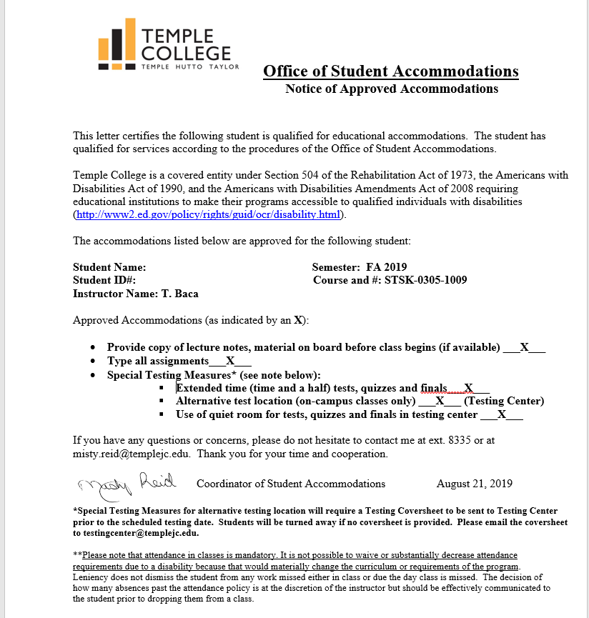
Example of an accommodation letter

Slide 18
TESTING CENTER ACCOMMODATIONS
Make sure you have an accommodation letter for the student for current semester on file
Send a testing coversheet to testing center prior to test date
Students will be turned away if coversheet is not sent
Testing coversheet must state approved accommodations only- EX: Extended time to test (Hour and a half), use of calculator, use of scratch paper on test
Email coversheet to: testingcenter@templejc.edu

Slide 19
FERPA
Are you breaking the law if you ask a student about their disability?
The answer is Yes. You cannot approach a student and ask, “What is your disability?” or “Why do you need accommodations?” BUT… this does not mean you cannot talk to the student about accommodations

Slide 20
FERPA
You CAN approach a student who has been issued a letter of accommodation and ask him/her if he/she has any questions for you regarding his/her accommodations or let him/her know that if he/she has any questions or concerns that you are willing to talk/work with him/her.
Taking a genuine interest in the student’s educational success is not a crime. It builds a relationship of trust that goes a long way in a classroom and in in life.

Slide 21
U.S. DEPARTMENT OF JUSTICE ADA REQUIREMENTS FOR SERVICE ANIMALS
Under the ADA, State, and local governments, business, and nonprofit organizations that serve the public generally must allow service animals to accompany people with disabilities in all areas of the facility where the public is normally allowed to go.
Under the ADA, service animals must be harnessed, leashed, or tethered, unless these devices interfere with the service animal's work or the individual's disability prevents using these devices.
Only dogs are recognized as services animals.
Service dogs in training are also permitted under the ADA guidelines.

Slide 22
HOW TO IDENTIFY A SERVICE DOG
Ask only the two approved ADA questions:
If there are no visual signs of service performance, or the dog does not behave in the manner of a highly trained service dog, you can ask only the following two questions:
1. Is the dog a service animal required because of a disability?
2. What work or task has the dog been trained to perform?

Slide 23
HOW TO AVOID DISABILITY DISCRIMINATION
You cannot ask about the person’s disability.
You cannot ask or require medical documentation of the disability.
You cannot ask or require a special identification card or training documentation for the dog.
You cannot ask the dog to demonstrate its ability to perform the work or task

Slide 24
DON’T PANIC!!
Only Persons with Service Animals are allowed to file for discrimination under ADA, Office of Civil Rights, and Texas Service Animal statues.
They are trained to avoid potential inquiries by having their dogs wear service dog vests. (Some service dogs may not wear vests-if interferes with the service they provide)
They are trained how to properly answer the two ADA questions

Slide 25



QUESTION AND ANSWER SESSION

